Slide 1
Technical Evaluation 2
IDP – JOÃO PAULO FONSECA

Slide 2
SOFTWARES USED
JAVA DEVELOPMENT KIT 11
MAVEN (latest version)
DOCKER ENGINE
POSTMAN

Slide 3





theme

Slide 4
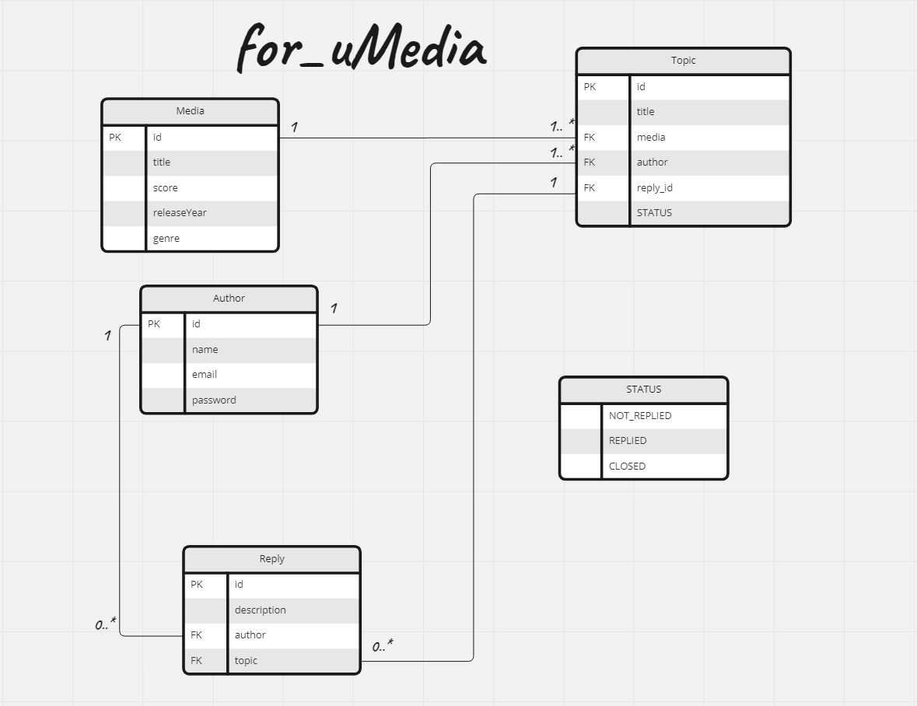
UML

Slide 5
functionalities
Create
Read
Update
Delete

Slide 6
Get
GetMedia
GetOneTopic
GetAllTopic
getByMediaName

Slide 7
post
PostTopic
PostReply

Slide 8
put
ClosingTopic

Slide 9
tests
Adapter
Controllers
Services

Slide 10
Questions?

Slide 11
Thanks for watching presentation!
And also thanks for your feedback!

